Slide 1




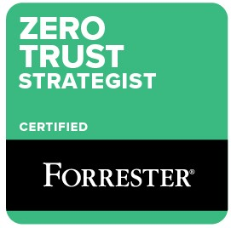
Zero Trust Business Strategy
Abbas Kudrati
APAC Chief Cybersecurity Advisor
Microsoft
@askudrati

Slide 2
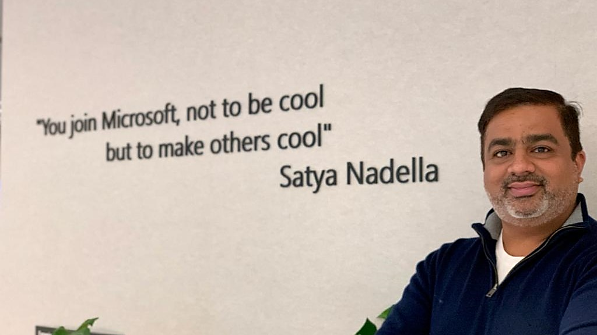
About me
Cybersecurity practitioner and CISO with 25 years of experience in Information / Cybersecurity.
Part time Cybersecurity Professor with Deakin and LaTrobe University in Melbourne, Australia.
Expertise in Zero Trust, Cybersecurity Strategy, Security Operations, Risk, Compliance, Cloud Security and Architecture.

Slide 3
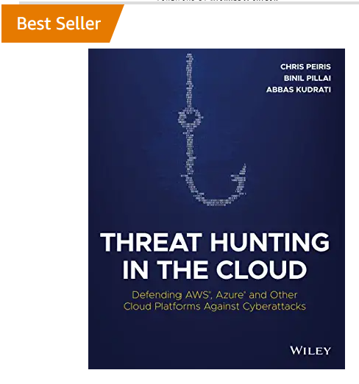
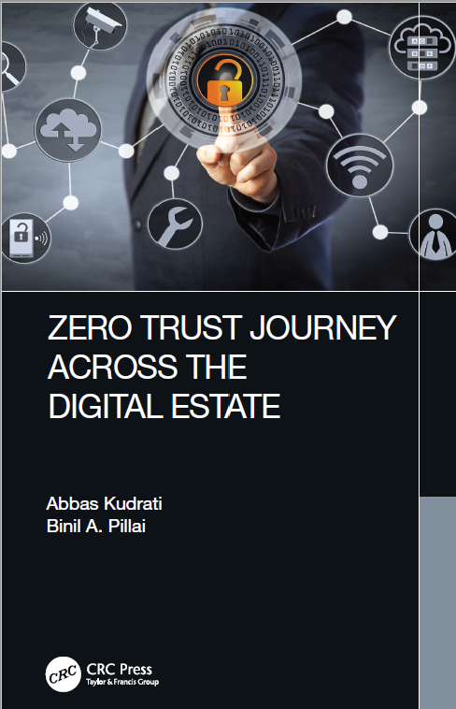

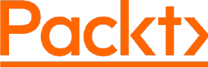
My Publications
DIGITIZATION RISKS IN POST-PANDEMIC WORLD
Ashish Kumar
Abbas Kudrati
Shashank Kumar
Work in progress
Get it on Amazon
Or send me a request for a free copy
Pre order on Amazon
Releasing soon by July 2022

Slide 4
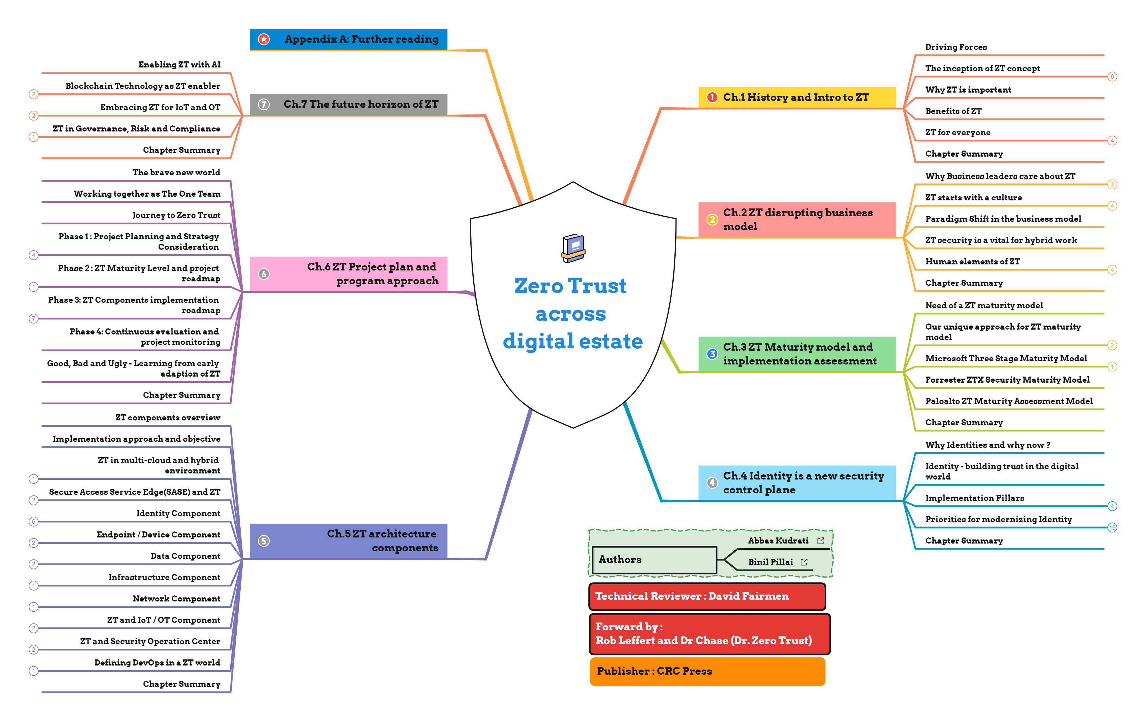
My ZT Book Mid map

Slide 5




Today’s reality | Distributed and hybrid
The tools we use are varied, from corporate to BYOD, cloud-based, or on-prem apps.
Where we work has continued to rapidly evolve to a mix of locations.
How we do our work is an evolving mix of virtual, physical, collaborative, and data-driven styles.
Evolving risks Increasing volume and sophistication of threats, and a wider, more distributed attack surface.
Notes:
The global pandemic put all of us on an accelerated path of digital transformation and has brought to light many difficult challenges organizations must face.
The traditional network and security perimeter model has disappeared. Where we work has evolved to a mix of locations and models from remote to hybrid. No matter where workers are, access to variety of tools are essential to be productive.
And on top of this, organizations are dealing with an increasing volume and sophistication of threats. We’ve all seen or heard the headlines – Nobelium, Colonial Pipeline, just to name a few.
The threat landscape has and continues to evolve. Cyber attacks​ are on the rise during the pandemic. The rush to scale remote work last year has left potential security vulnerabilities. The use of personal devices at home to access work data is difficult to manage and protect. And on top of that, organizations lack skilled security personnel and must keep up with evolving data privacy and industry regulations.
This new reality requires a Zero Trust approach to security.

Slide 6



Where are you on zero trust journey?
?
“not trusting people” ???
Identity View
0
Don’t know about it
Network view
“It’s a product”
Notes:
Currently we typically encounter one of 3 customer mindsets/experience on zero trust
Don’t know much about it
Have an expectation of what it is
Aligned to Identity and/or Jericho paradigm
Aligned to networking / Microsegmentation view (e.g. cisco / BeyondCorp approach)
Have an odd interpretation of it (such as not trusting people)

Slide 7
Introduction - Why Zero Trust is Important
Notes:
Targeting 15 minutes

Slide 8
The world is transforming rapidly
Market
Business
Attackers
Technology
Security
Notes:
Key Takeaway: Organizations are adapting to three simultaneous transformations at once – business, technology, and security
Now let’s shift to what we see happening to organizations like you, both the challenges and the bright spots we can all learn from.
Nearly every organization is undergoing some form of top to bottom transformation because customers now strongly prefer companies they can rapidly interact with over mobile applications and cloud technologies. This disruption of existing market dynamics forces organizations to transform to compete with technology native startups (like Amazon and Uber) and traditional competitors that are digitally transforming.
This Market Transformation kicks off a digital Business Transformation in the organization to capture new opportunities and stay competitive.
CLICK 2 - Technology transformation
This digital transformation requires a Technology Transformation for the IT organization to integrate cloud services, modernized development practices, and related changes to keep up with the rapid market evolution.
CLICK 3 - Security Transformation
This should then lead to a Security Transformation that protects these new cloud assets and simultaneously takes advantage of these technologies to better manage threats and security risk
CLICK 4 – Attacker Evolution
Unfortunately, security organizations often function as a kind of “last step” quality gate before release that has to justify budget as a special Capital Expenditure (CapEx).
This engagement model makes it challenging for security to transform, often causing business and IT stakeholders to skip security in order to quickly respond to market needs.
Simultaneously there has been an attacker evolution where attackers rapidly adapt to add these new assets to their list of easy targets
Attack these lower security workloads that are critical to business growth
Find new ways to attack existing assets (both in business models like ransomware and in technical attack techniques)
This creates increased security risk for new workloads and attackers.
Click the zoom for more information on how too little security and too much security (overly restrictive security) lead to the same outcome.

Slide 9
Working together
Business
Digital Transformation
Market
Attackers
Technology
Security
Zero Trust Transformation
Cloud Transformation
Notes:
Key Takeaway: Everybody must work together during continuous transformations to manage the dynamic market and threat environments
The hallmark of successful organizations that are thriving is that different teams across the organization are working together to managed these dynamic challenges.
Each team in the organization is undergoing their own massive transformation and figuring it out as they go. Nobody has a clear detailed long term plan that will be accurate in a year.
Recognizing that everyone is adapting to a changing environment will help you better navigate these simultaneous changes:
Digital Transformation - Businesses are constantly reading the market and adjusting plans to ensure they are on the right track
Cloud Transformation - Technology organizations are constantly working to keep up with the innovation from the cloud providers (for their own efficiency/effectiveness reasons + helping enable digital transformation)
Zero Trust Transformation – Security is constantly adapting to the changing threat environment + changing technology platform driven by cloud + changing attack surface and priorities based on the digital transformation.
To enable this, organizations should build a culture that increases empathy for each other, builds productive relationships, shares context across these disciplines, and encourages learning and collaboration.
Its critical for everyone to work together to manage the dynamic market and dynamic threat environment so that the organization stays safe and reduces risk in the time of transformation that we are in.
Additional notes:
Each transformation consistent (general) goal of what they are trying to achieve, but the details and processes are often changing frequently.
This is challenging at many organizations that have a traditional silo’ed approach. Business leaders need to set a tone and a culture, model it, and hold their people accountable to do the same

Slide 10
What is Zero Trust?
Assume breach | Explicitly Verify | Least privileged
Zero Trust Security Strategy - includes multiple modernization initiatives
Modern Access Control
Modern approach to access management
Modern Security Operations (SOC)
Infrastructure & Development Security
Data Security & Governance, Risk, Compliance (GRC)
IoT and OT Security
Secure Access Service Edge (SASE)
Modernization, Integration, and Automation across technical controls
Identity, Endpoint, Network, Application, Infrastructure, Data, and Infrastructure
Notes:
Zero Trust access control is usually the first and most urgent initiative of an overall zero trust strategy
The same underlying forces (cloud, digital business, attacks evolving to bypass perimeter defenses) are driving security forward in multiple ways at the same time.
Describe the journey and continuyous nature of it, but that it is a concrete and specific model being formalized by the open group, NIST, and others
identity is a foundational component across security and a big part of the first key scenario of zero trust (ZT Access Control
Network is also foundational component and another main part of the zt access control
This doesn’t replace defense in depth, it restructures it to the world of today

Slide 11
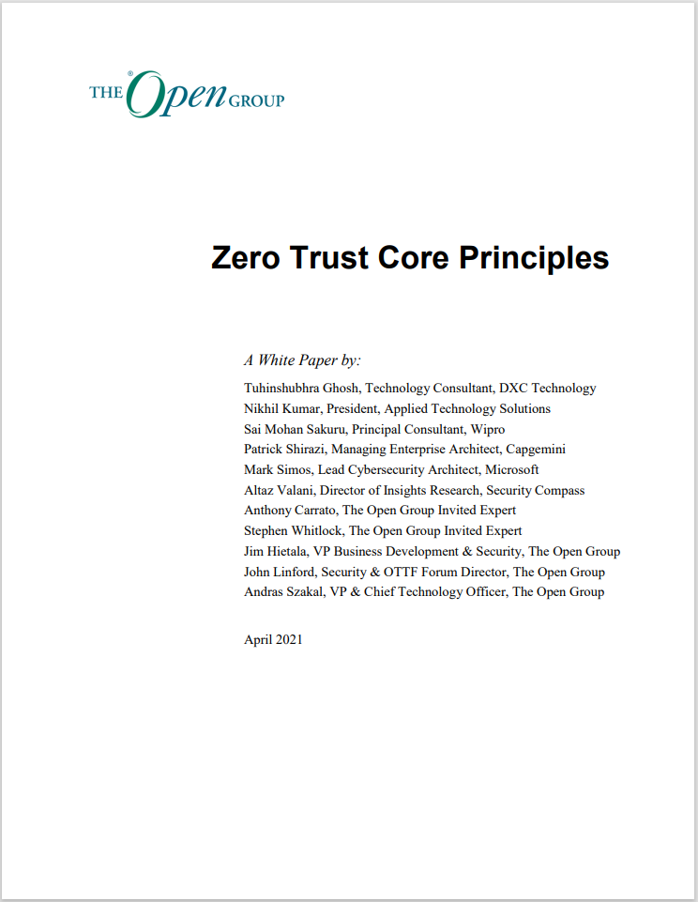

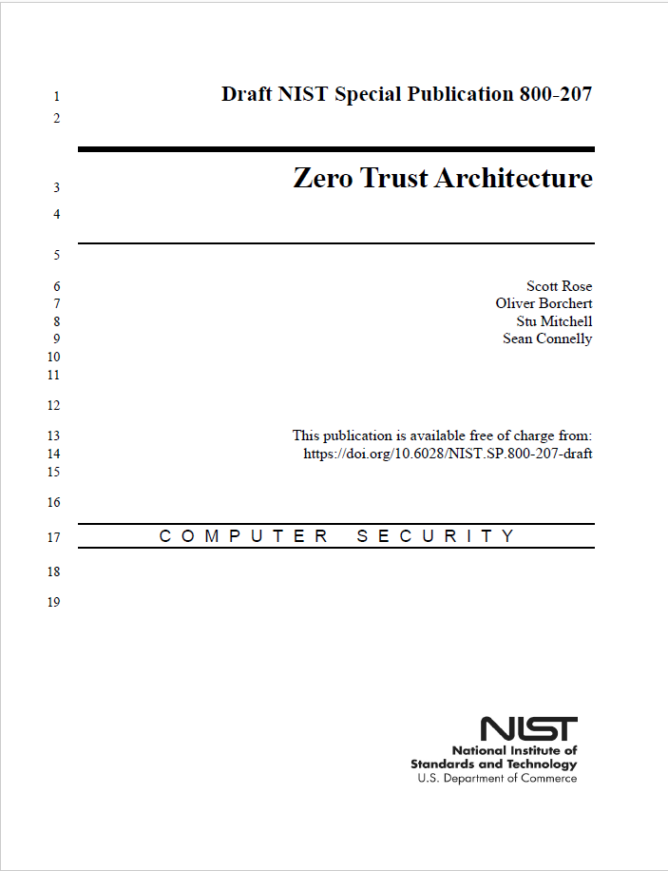
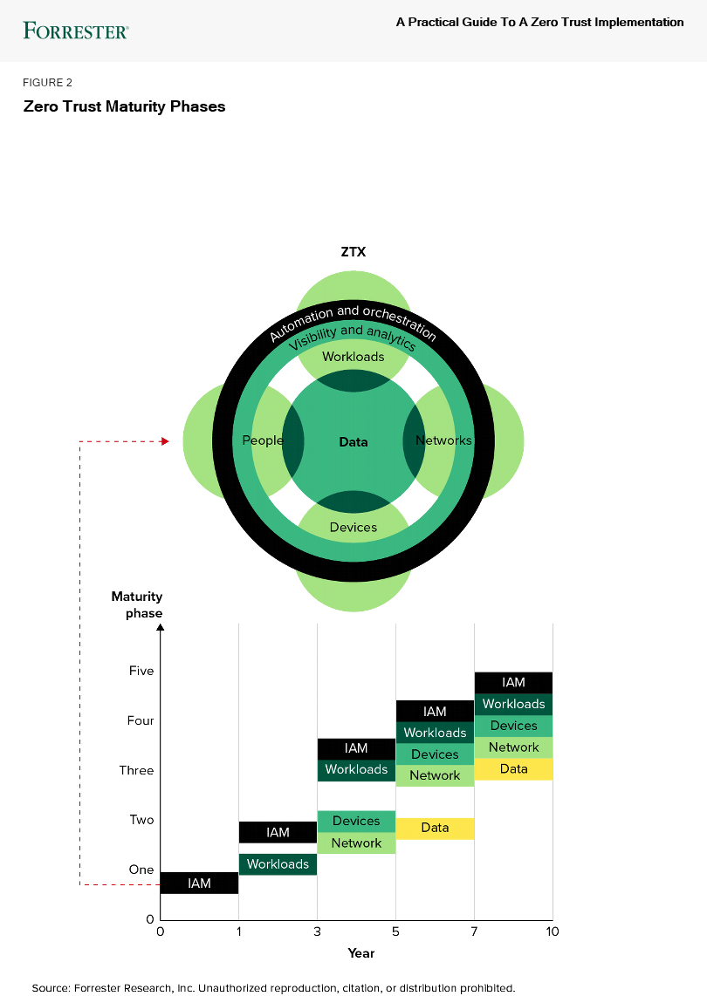
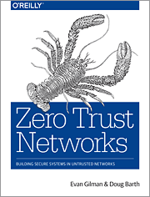
“Zero Trust” has been around for a while
The Open Group
(Home of the Jericho Forum, TOGAF, and more)
NIST
2004 Jericho Forum Formally Established
2014 Microsoft Advocates “Assume Breach”
2016 Conditional Access Released
Ongoing
Passwordless Initiative
Today
~2004 Network Access Control (NAC) Architectures
2010 Forrester coins “Zero Trust” Term
2014 BeyondCorp Published
2017
Forrester
ZTX Model
Historically slow mainstream adoption for both network & identity models:
Network – Expensive and challenging to implement
Google’s BeyondCorp success is rarely replicated
Identity – Natural resistance to big changes
Security has a deep history/affinity with networking
Increasing consensus and convergence (though still some variations)

Slide 12
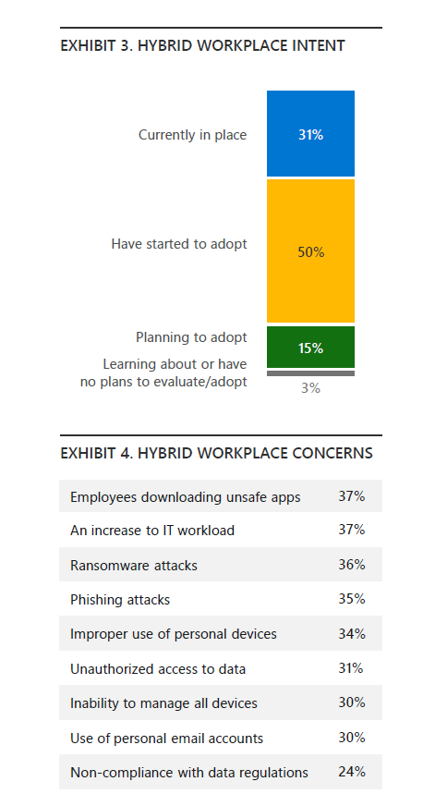
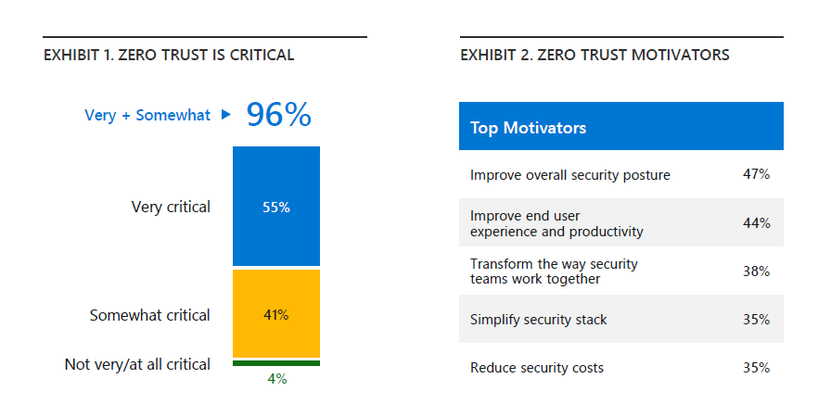
Zero Trust Adaption report 2020 /21

Slide 13
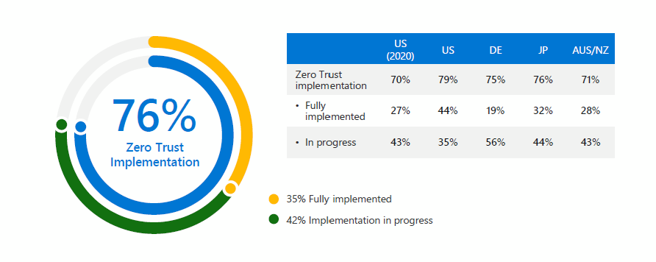
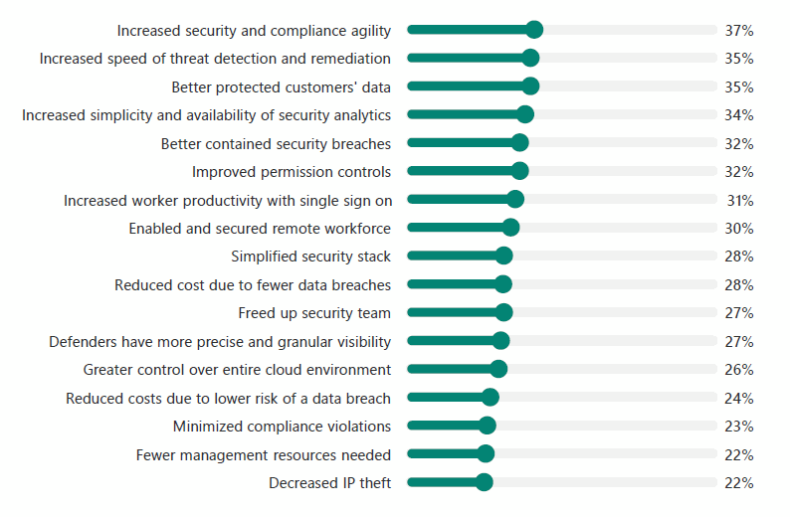
ZT Adaption Report findings

Slide 14



Perspectives on A Journey that affects everyone a little differently
Zero Trust Security Strategy
Digital Transformation
CEO
Business Drivers and Benefits
CFO
COO
CIO
CISO
Zero Trust Security Strategy
Enterprise Strategy and Priorities
Zero Trust Implementation
Technical Architecture and Implementation
Notes:
Key Takeaway - Zero Trust looks different from different perspectives in the organization
Note that there is a lot of overlap on the system, as everyone has to translate their boss’s priorities into their own actions (and often into objectives for their team)

Slide 15

What Zero Trust is not about…
Literal
An Adjective
For Sale
Instant
A Destination
One Size Fits All
A Revolution
Notes:
Literal. Trusting absolutely nothing in your environment is neither pragmatic nor possible. While you want to approach security investments with the assumption that any component can fail, you have limits on your time and resources – absolutism isn’t going to help you make smart prioritization decisions.
An Adjective. You aren’t going to “be” Zero Trust. A product can’t “be” Zero Trust. Zero Trust is an approach to securing your assets – a mindset which will guide your strategy and investments.
For Sale. You can’t buy and install a product and “become” Zero Trust (not even ours!). In a world where we assume pervasive risk, trusting one angle, one approach, one product completely is counter intuitive.
Instant. Unwinding the assumptions in your environment will take time. Prioritize based on your biggest blind spots. Pick a corner to work out of – like cleaning a messy room, start with one surface, get it working well, and move on.
A Destination. This is a mindset you are adopting – a mindset of continuously questioning your assumptions, of looking for gaps in your telemetry, of fundamentally doubting your defenses. Once you adopt this mindset, you will spend your career applying it to prioritizing your investments.
One Size Fits All. The right investments for your organization are a function of where you are now, what you are defending, how your staff works, your strategy for infrastructure investments. Your approach to Zero Trust will be a function of your current reality and your wisdom.
A Revolution. As discussed in the history of changes leading to the Zero Trust concept, cyber security models (e.g. “defense in depth”) have been evolving for decades. Much of what you have adopted is necessary – but probably not sufficient. Use what you know and use what you’ve deployed. But don’t use it as an excuse to make assumptions about your environment.

Slide 16
ZT Business Strategy
Create clarity
Synthesize the complex
Ensure shared understanding
Value understood
Generate energy
Inspire optimism, creativity, and growth
Create an environment where everyone does their best work
Build organizations/teams that are stronger tomorrow than today
Deliver success
Drive innovation that people love
Be boundary-less in seeking solutions for the Zero Trust program
Tenaciously pursue the right outcomes

Slide 17
Do’s and Don’t
Is ZT right for you ?
Gain support from and buy in from key executives
Identifying key inter dependencies across the organization
Understanding your information assets.
Understanding your user population
Identifying your application exposure / risk exposure
Understanding and grouping of key business user population and core application combination
Start with few basic fine-grained controls

Slide 18

Next Steps
Prepare, engage and unify key stakeholders across your organization on your vision for Zero Trust.
Start the discovery of your current state and objectives for the Zero Trust program.
Identify personas for your Zero Trust program.
Work together with Microsoft to Identify capabilities and technical security gaps in your existing environment.
Document and prioritize in a solution backlog prior to Program/Sprint planning.
Notes:
Talk track:
As you’ve seen, the digital estate has grown into a complicated constellation of identities, applications, data, virtual machines, endpoints, and IoT devices. Siloed solutions simply cannot address the scale and complexity.
We recognize that protecting your enterprise means more than having insight into threats to just your Microsoft assets—you need to protect every asset. Wherever your assets exist—on-premises, on cloud (Azure, or even on AWS)—Microsoft's integrated and holistic approach to Zero Trust can meet you where you are.
While a Zero Trust security model is most effective when integrated across the entire digital estate, most organizations will need to take a phased approach that targets specific areas for change based on their Zero Trust maturity, available resources, and priorities. It will be important to consider each investment carefully and align them with current business needs. The first step of your journey does not have to be a large lift and shift to cloud-based security tools. Many organizations will benefit greatly from utilizing hybrid infrastructure that helps you use your existing investments and begin to realize the value of Zero Trust initiatives more quickly.
Fortunately, each step forward will make a difference in reducing risk and returning trust in the entirety of your digital estate.

Slide 19
Appendix: Resources and Learning links

Slide 20
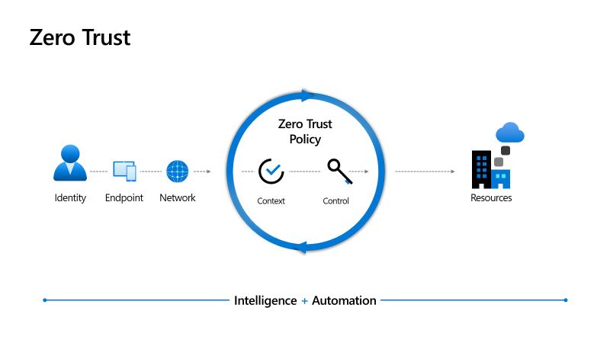
Zero Trust networking maturity model
Traditional
Advanced
Optimal
Few network security perimeters and flat open network
Minimal threat protection and static traffic filtering
Internal traffic is not encrypted
Many ingress/egress cloud micro-perimeters with some micro-segmentation
Cloud native filtering and protection for known threats
User to app internal traffic is encrypted
Fully distributed ingress/egress cloud micro-perimeters and deeper micro-segmentation
ML-based threat protection and filtering with context-based signals
All traffic is encrypted
Microsoft has rich set of cloud native services designed to help you move to zero trust model
Learn more about zero trust networking at https://www.microsoft.com/security/blog/2020/06/15/zero-trust-part-1-networking/
https://www.microsoft.com/en-us/security/zero-trust
Notes:
Sinead – 5 mins whole section. Finish at slide 20 at 23 mins at end.

Slide 21

Zero Trust Rapid Modernization Plan (RaMP) Prioritize rapid progress on highest positive impact
Roll out to IT Admins first
Targeted by Attackers
High potential impact
Provide technical feedback
Top Priorities – critical security modernization steps
Explicitly validate trust for all access requests (via Azure AD Conditional Access)
User Accounts - Require Passwordless or MFA for all users + measure risk with threat intelligence & behavior analytics
Devices - Require device integrity for access (configuration compliance first, then XDR signals)
Increase security for accessing key resources
Apps – Enable Azure AD for all SaaS, for VPN authentication, and publish legacy on-premises/IaaS via App Proxy
Data - Discover and protect sensitive data (via Cloud App Security, CA App Control, Microsoft Info Protection)
Governance to continuously monitor security posture and reduce risk (via Secure Score)
User Access and Productivity
Modernize Security Operations
Streamline response to common attacks with XDR for Endpoint/Email/Identity + Cloud (via M365 & Azure Defender)
Unify Visibility with modern Security Information and Event Management (SIEM via Azure Sentinel)
Reduce manual effort - using automated investigation/remediation, enforcing alert quality, & proactive threat hunting
As Needed – typically driven by cloud adoption or OT/IoT usage
Discover – Find & classify assets with business critical, life safety, and operational/physical impact (via Azure Defender for IoT)
Protect – isolate assets from unneeded internet/production access with static and dynamic controls
Monitor – unify threat detection and response processes for OT, IT, and IoT assets (via Azure Defender for IoT)
Operational Technology (OT) and Industrial IoT
Datacenter & DevOps Security
Security Hygiene – Rigorously monitor + remediate security configurations, security updates, MFA, and more
Reduce Legacy Risk – Retire or isolate legacy technology (Unsupported OS/Applications, legacy protocols)
DevOps Integration – Integrate infrastructure + development security practices into DevOps with minimal friction
Microsegmentation – Additional identity and network restrictions (dynamic trust-based and/or static rules)
ZT builds on classic security
Align to cloud migration schedule
Notes:
Key Takeaway: These are the recommended priorities to rapidly modernize security using Zero Trust
These initiatives represent the natural grouping of efforts we commonly see at organizations. For each initiative, we have highlighted recommendations on where to start
User Access and Productivity
The first initiative at many organizations is focused on security visibility and control for newer productivity resources (cloud and mobile) assets outside of the traditional corporate network security perimeter.
User Access and Productivity (Users Accounts and Devices)
This often starts with establishing an identity ‘security perimeter’ for cloud applications and mobile devices that uses identity as the control plane and explicitly validates trust for user accounts and devices before allowing access
1a. User Accounts - The top priority is to require strong multi-factor authentication (MFA), (and preferably Passwordless authentication). Attackers have easy availability to compromised username/passwords and commonly used passwords, so organizations must prioritize moving beyond password-only authentication as their first step.
1b. Devices – This should be quickly followed by measuring productivity device assurances before allowing access from them. Many attackers have mastered techniques to compromise user devices, steal credentials from them, and use those to continue attacking the environment.
CLICK 1 – User Access and Productivity (Apps and Data)
The next priority in this initiative is to extend those new advanced controls to
2a. Apps – improve access security across your estate by using the Azure AD authentication security you configured in step 1, starting with SaaS applications. Configure Azure AD for all of your sanctioned Software as a Service (SaaS) applications.
Then, enable security for applications that don’t directly support modern protocols like OAuth/OIDC and SAML by modernizing and then going beyond VPN authentication in a two-step process
Improve VPN Security - By connecting your VPN appliance to Azure AD authentication, VPN sessions benefit from the added security of explicit validation of user account/session and device trustworthiness.
Publish Applications – Move applications off of VPN by publishing existing on-premises (and IaaS) applications through Azure AD App proxy, enabling you to take advantages of strong Azure AD authentication from step 1, improve user experience, and limit accounts to accessing a single application at a time (instead of a VPN that typically provides access to all ports/protocols of the whole network).
2b. Data – Next, you should focus on securing data itself. Whether you already have a traditional data loss protection (DLP) approach or not, you should focus on securing data:
Wherever it goes (cloud services, USB Devices, corporate endpoints and servers, etc.) with a full lifecycle approach that goes beyond a Expand the program (or build a new one)
With a full lifecycle approach (discovery, classification, protection, and monitoring
Based on your data security priorities, select technologies that help enable this like Microsoft information protection (MIP) that encrypts data and requires authenticating to a cloud service for the decryption key. Microsoft Cloud App Security can also discover unstructured data on cloud apps and application sessions, and Azure Purview to discover and classify structure data.
CLICK 1 - Modern security operations (SecOps)
Another top priority initiative that organizations often run in parallel to user access and productivity is the modernization of security operations. This focuses on threat detection, response, and recovery capabilities for new cloud applications, remote devices, identities, and other assets outside of the traditional security perimeter, complementing the preventive access controls.
Modernizing security operations with Zero Trust requires rigorous prioritization to ensure that SecOps teams are focused on the greatest risk to the organization, aren’t wasting time on false alarms/false positives, and have the broad and deep visibility across the entire estate they need to be effective.
4. Streamline Responses - The first priority for SecOps is to master threat response and remediation on commonly attacked resources using
Extended Detection and Response (XDR) technology provide high quality alerts for these new resource types, bypassing the manual effort and delays when trying to build every alert in a SIEM (security information and event management).
Streamlining the processes for these common attacks. Focusing the triage (Tier 1) and investigation (Tier 2) analyst teams on mastering these attacks will catch both commodity and advanced attackers earlier in the process, reducing risk to the organization.
5. Unify Visibility – While it’s difficult to create a high-quality individual alerts from raw data in SIEMs, they are extraordinarily useful for bringing all the data and context together for investigations and for threat hunting, allowing for a broad view across your entire estate (reducing blind spots where attackers may dwell).
6. Reduce Manual Effort
At all times, security operations should be focused on reducing toil/suffering from manual and repetitive tasks like switching tools, typing commands, copy/pasting data, etc. Focusing on giving analysts a streamlined end to end integrated experience with Security Orchestration, Automation and Response (SOAR) technology will increase both effectiveness and morale. SOAR technology is built into both Microsoft 365 Defender and Azure Sentinel.
CLICK 2 - Operational technology
If your estate includes Operational Technology (OT) and Industrial IoT, the next priority is to apply Zero Trust principles to these environments.
Securing these environments and architectures are often constrained by having older hardware and software, so you should focus on a process of discovering these assets, protecting them by isolating vulnerable and/or important workload from internet and intranet connectivity, and monitoring them with security tools made for the environment (passive monitoring that doesn’t risk crashing older applications and operating systems).
Azure Defender for IoT is designed for discovering these assets and monitoring them in a non-intrusive way, while applying sophisticated anomaly detection (and optionally connecting to Azure Sentinel in the cloud for further analytics and correlation if desired).
CLICK 3 - Datacenter security
The focus areas for datacenter zero trust should be to
Security Hygiene – Focus first on applying well established security best practices to datacenters. Just as physical equipment like bulldozers and manufacturing lines require regular maintenance (oil changes, etc.) to perform reliably, so too do computer systems (though computer security maintenance failures typically happen suddenly like sloppy fire safety procedures at a fireworks factory). Misconfigurations and missing security updates can undermine or negate almost all other security controls by allowing attackers bypass the security boundaries that these architectures assume are in place. Use Secure Score in Azure Security Center to get visibility into these issues across Azure, on-premises, AWS, GCP, and other clouds. For more information on secure score, see https://docs.microsoft.com/azure/security-center/secure-score-access-and-track
Reduce Legacy Risk – Discover and (build plans to) retire legacy technologies with high security risk like legacy authentication protocols and unsupported operating systems. Attackers with network access can rapidly exploit these to expand their access to the environment, so paying down this technical debt is a worthwhile investment. Azure Security Center can provide discovery and measurement of this for multi-cloud and on-premises resources.
DevOps Integration – Integrate security into DevOps processes as seamlessly as possible to provide healthy security friction (causes critical thinking and analysis) while avoiding unhealthy friction (impedes more value than it protects). In the ideal state, teams collectively align to goals of innovation speed, reliability, and security resilience. For more information see security innovation in https://aka.ms/cafsecure
Microsegmentation – Apply the concept of microsegmentation with a blend of both identity and network controls. Restricting access to resources into smaller ‘segments’ reduces risk by limiting the ‘blast zone’ of any compromised datacenter resource (which limits an attackers' ability to access other datacenter resources, applying the least privilege principle). Components that support this approach include
Just in Time (JIT) VM Access – This blocks management ports used by admins (and targeted by attackers) without restricting ports/protocols for customers and employees. For more information, see https://docs.microsoft.com/azure/security-center/just-in-time-explained
Note: This is separate from just in time approval for administrative privileges found in Azure AD PIM and 3rd party capabilities - https://docs.microsoft.com/azure/active-directory/privileged-identity-management/pim-configure
Network Filtering (Internet Firewalls and IDS/IPS) – Most existing/legacy applications were implemented and are operated with the assumption that they are on a private network (behind firewalls, IDS/IPS, and/or WAF), so its critical to ensure these practices are followed on the cloud (until/unless they are refactored to cloud native applications). As organizations move to Azure, they can choose to directly extend their existing capabilities with network appliances or they can choose to adopt native capabilities like Azure Firewall and WAF. For more information, see https://docs.microsoft.com/azure/cloud-adoption-framework/security/security-top-10#7-technology-integrate-native-firewall-and-network-security
Network filtering (within Datacenter) This is traditionally one of the most difficult elements to execute successfully because applying granular network controls within a datacenter static controls requires a deep understanding application workflows to avoid breaking business critical application functionality with security controls. Microsoft provides native controls within Azure to filter traffic:
Network Security Groups - https://docs.microsoft.com/azure/virtual-network/network-security-groups-overview
Application Security Groups - https://docs.microsoft.com/azure/virtual-network/application-security-groups
Internal Resource Authentication – In addition to the protections in steps 1 and 2, identity teams and workload owners should work to ensure servers, applications, and services authenticate before communicating to each other. This limits the access any compromised resource has to other applications, VMs, account, or other resources, increasing cost and friction for attackers. For more information on managed identities, see https://docs.microsoft.com/azure/active-directory/managed-identities-azure-resources/overview
Zero Trust Datacenter Tips
Align with cloud initiatives – As you move workloads to the cloud, we recommend introducing zero trust principles to the design of enterprise and workload security. Retrofitting these protections to an on-premises datacenter is often difficult and requires working with each individual workload and application (which can number in the hundreds, thousands, or more). Because a cloud migration is already inventorying and working with application/workload owners, adding zero trust protections as you go to the cloud is the best natural integration point.
Move devices to internet faster – End user devices and datacenters share a network until those devices move to internet only mode. The sooner this happens, the sooner that your intranet shrinks into a smaller private datacenter network that is easier to isolate from risk. Getting to this state requires users and devices to get all their apps from either SaaS or published legacy apps (via Azure AD proxy or similar) so that they no longer need direct (or VPN) access to the datacenter networks.

Slide 22

Zero Trust Resources
Zero Trust page: https://aka.ms/zerotrust
Business Plan: aka.ms/ZTbizplan
Zero Trust maturity model: https://aka.ms/ztmodel
Zero Trust assessment: https://aka.ms/zttool
Zero Trust deployment guidance: https://aka.ms/ztblogs
Implementing a Zero Trust security model at Microsoft LINK
Microsoft’s approach to Zero Trust Networking and supporting Azure technologies LINK
Microsoft helps employees work securely from home using a Zero Trust strategy LINK
Zero Trust: Security Through a Clearer Lens session (Recording | Slides)
CISO Workshop Slides/Videos
Microsoft’s IT Learnings from (ongoing) Zero Trust journey

Slide 23







Zero Trust Program Approach (Example)
Sprint 0
Sprint Program
3-4 weeks
2 weeks
n weeks
Discovery
Sprint planning
Epics
Day 1
6 to 9 days
2 Weeks
2 Weeks
4 Weeks
4 Weeks
Zero Trust Program
Initiation (This workshop)
Governance (½ - 1 day)
Identities (1 – 1½ day)
Devices (½ - 1 day)
Apps (½ - 1 day)
Infrastructure (1 day)
Network (1 day)
Data (½ - 1 day)
Security Management (1 – 1½ day)
Zero Trust Maturity Assessment Program Roadmap
Delivery Sprints planning
Delivery Sprints
Key Outcomes
Briefings, Maturity Scoring
Roadmap
Milestone Plan, Backlog
Sprint Reporting
Sprint Reporting
Kick-Off
Workshops & Deep Dives
Program Tracks
Sprint Planning
Sprint 1
Sprint n
Customer Objectives Workshop
Microsoft and Zero Trust Brief
Review Pre-Engagement Questionnaire
Introduction to Agile Delivery Approach
Topic-focused strategic and technical discovery/briefings aligned to Zero Trust/Microsoft Secure Pillars
Capabilities and Personas Selection
Technology and capability deep dives
Define and structure Objectives and Key Results (OKR’s)
Clear set of outcomes defined in Azure DevOps (ADO)
Program Roadmap by track
Report out to key stakeholders
Recommendations and priority delivery
Create a Risk Register to capture any blockers during the Zero Trust Journey
Sprint Plan define & prioritize epics
Sprint Solution Backlog
Establish Tooling
Define Sprint Burndown
Daily Standups
Demonstration
Retrospective
Sprint 1+ planning
Increment 1
Daily Standups
Demonstration
Retrospective
Sprint 1+ planning
Increment N

Slide 24
Thank you! https://aka.ms/abbas

